Slide 1


Welcome!
Workshop
3 of 7

Slide 2
Today's Topics
Review of Workshop 2
Loops
While
For
Auto-indexing
Shift registers
Case Structure

Slide 3
Review Question 1
True or False?
Arrays can contain only one data type.
An array must contain at least one element.
The Bundle function can be used to add elements to a cluster.
Clusters can contain both controls and indicators within the same shell; however, arrays cannot.
It is possible to have clusters containing arrays as well as arrays containing clusters.

Slide 4
Review Question 1
True or False?
Arrays can contain only one data type. TRUE
An array must contain at least one element. FALSE
The Bundle function can be used to add elements to a cluster. FALSE
Clusters can contain both controls and indicators within the same shell; however, arrays cannot. FALSE
It is possible to have clusters containing arrays as well as arrays containing clusters. TRUE
Notes:
Arrays can contain only one data type; clusters, however, can contain multiple data types.
An uninitialized array has a dimension of zero; therefore, it contains no elements
The bundle function can be used to build or create a cluster, but elements cannot be added to a cluster. A cluster is a finite size. The values of the elements can be changed using the bundle or the bundle by name functions.
Neither arrays nor clusters can contain both controls and indicators simultaneously. They are either a control OR an indicator
You cannot have arrays within arrays (this is essentially a multidimensional array), but other combinations of arrays and clusters are possible. For example you can have an array within a cluster, which is within an array.

Slide 5
Review Question 2
The Error Cluster contains which of the following?
Boolean
Array
String
Numeric
Cluster

Slide 6
Review Question 2
The Error Cluster contains which of the following?
Boolean - status
Array
String - source
Numeric - code
Cluster

Slide 7
Review Question 3
An enumeration is a list of ___ and ___ pairs and acts like a ____ to the computer and ____ to the user.
integer, string, integer, string
Boolean, string, boolean, string
Boolean, integer, boolean, integer
integer, string, string, integer

Slide 8
Review Question 3
An enumeration is a list of ___ and ___ pairs and acts like a ____ to the computer and ____ to the user.
integer, string, integer, string
Boolean, string, boolean, string
Boolean, integer, boolean, integer
integer, string, string, integer

Slide 9

Loops
Use loops when you want to repeat a section of code
Types:
While – repeats until a condition is met
For – repeats for X number of iterations

Slide 10
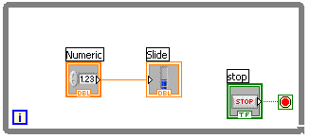
While Loops
terminal counts the number of iterations; zero indexed
Always runs at least once (therefore, really a do-while loop)
Runs until stop condition is met
Stop if TRUE
Continue if TRUE
While Loop
Conditional terminal
Iteration terminal
Notes:
While Loops
Similar to a do-while loop or a repeat-until loop in text-based programming languages, a while loop executes a subdiagram until a condition is met. The while loop executes the sub diagram until the conditional terminal, an input terminal, receives a specific Boolean value. The default behavior and appearance of the conditional terminal is Stop If True. When a conditional terminal is Stop If True, the while loop executes its subdiagram until the conditional terminal receives a TRUE value. In other words, a while loop will repetitively execute the subdiagram (code within the boundaries of the loop) and stops executing the only if the value (True or False) sent to the conditional terminal meets the condition (continue if true OR stop if true)
The while loop is located on the Functions»Structures palette.
The iteration terminal (an output terminal), provides the number of completed iterations. The iteration count always starts at zero. During the first iteration, the iteration terminal returns 0.
Introduction to LabVIEW Hands-On 38 ni.com

Slide 11
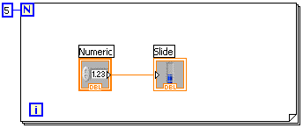
For Loops
i = zero indexed
N = one indexed
i Terminal counts iterations
Runs according to input N of count terminal
Count
terminal
For Loop
Iteration terminal
Notes:
For Loops
A for loop, shown above, executes a subdiagram a set number of times. The value sent to the count terminal (an input terminal) represented by the N, tells the loop how many times to repeat the subdiagram.
The for loops is located on the Functions»Structures palette.
It is possible to add a conditional terminal to a for loop by right-clicking on the border of the for loop and selecting Condition Terminal. [Note: This feature is only available in LabVIEW 8.5 and later]
The iteration terminal (an output terminal), contains the number of completed iterations. The iteration count always starts at zero. During the first iteration, the iteration terminal returns 0.
Introduction to LabVIEW Hands-On 38 ni.com

Slide 12
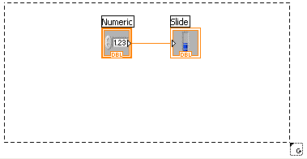
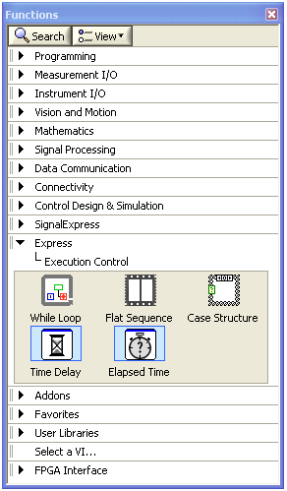
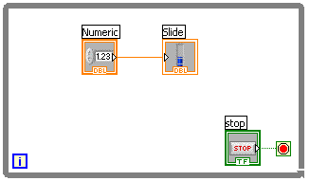
Creating a Loop
2. Enclose code to be repeated
1. Select the structure
3. Drop or drag additional nodes and then wire
Notes:
Place loops in your diagram by selecting them from the Functions palette:
When selected, the mouse cursor becomes a special pointer that you use to enclose the section of code you want to include in the while loop.
Click the mouse button to define the top-left corner and then click the mouse button again at the bottom-right corner. The while loop boundary appears around the selected code.
Drag or drop additional nodes in the While or For Loop if needed.
© National Instruments Corporation 39 Introduction to LabVIEW Hands-On

Slide 13
Demonstration:
Creating a Loop
Notes:
Introduction to LabVIEW Hands-On 24 ni.com

Slide 14
Building Arrays with Loops
Auto-Indexing Enabled
Loops can accumulate arrays at their boundaries with auto-indexing
For loops auto-index by default
While loops output only the final value by default
Right-click tunnel and enable/disable auto-indexing
Wire becomes thicker
1D Array
0 1 2 3 4 5
Auto-Indexing Disabled
Wire remains the same size
Only one value (last iteration) is passed out of the loop
5
Notes:
For loops and while loops can index and accumulate arrays at their boundaries. This is known as auto-indexing.
The indexing point on the boundary is called a tunnel
The for loop is auto-indexing-enabled by default
The while loop is auto-indexing-disabled by default
Examples:
Enable auto-indexing to collect values within the loop and build the array. All values are placed in the array upon exiting the loop.
Disable auto-indexing if you are interested only in the final value.
Tunnels are solid when auto-indexing is disabled. When auto-indexing is enabled, the tunnels appear to have brackets.
Introduction to LabVIEW Hands-On 59 ni.com

Slide 15
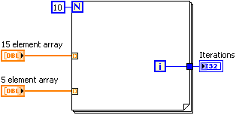
Auto-Indexing Input
If an array is passed into a For Loop and auto-indexing is enabled, the number of elements in the array determines the number of iterations of the For Loop (therefore, you are not required to wire the N terminal)
If the iteration count terminal is wired and arrays of different sizes are wired to auto-indexed tunnels, the actual number of iterations is the smallest of the choices.
Notes:
Iterations indicator would display 4 when this block diagram finishes because i is zero indexed and the loop iterates 5 times ( because the smallest choice is the 5 element array) [0,1,2,3,4]
Note: Technically speaking, we are assuming that the labels given to the arrays are accurately describing the number of elements in the array. The control terminal alone does not provide enough information to know if there are exactly 5 elements in the array, so we are making the judgment off the label of the array.
Introduction to LabVIEW Hands-On 59 ni.com

Slide 16
Shift Registers - Access Previous Loop Data
“Up and around the loop”
Left terminal provides stored data at beginning of next iteration
Right terminal stores data on completion of current iteration
Come in pairs that are always aligned with each other
Available at left and right borders of loop structures
To create:
Right-click the border and select Add Shift Register
Right-click an existing tunnel, select Replace with Shift Register, and click the opposite loop border to create other half of pair
Notes:
Shift registers transfer data from one iteration to the next:
Right-click on the left or right side of a for loop or a while loop and select Add Shift Register. Or right-click an existing loop tunnel and select Replace with Shift Register, then click the other side of the loop to create the other half of the shift register.
The right terminal (down arrow/triangle) stores the data wired to it at the end of an iteration. The data “goes up and around” to the left terminal (down arrow/triangle) and is available at the start of the next iteration.
A shift register adapts to any data type wired into it and will change color accordingly.
Introduction to LabVIEW Hands-On 83 ni.com

Slide 17
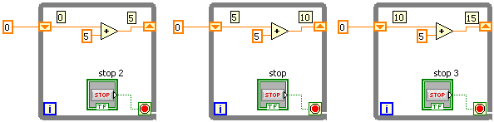
Shift Registers in action
Value 15
Initial
Value
Before Loop
Begins
First
Iteration
Second
Iteration
Last
Iteration
Notes:
In the example on this slide, an input of 0 would result in an output of 5 for the first iteration, 10 for the second iteration, and 15 for the third iteration. Shift registers are valuable for many applications that have memory or feedback between states.
Introduction to LabVIEW Hands-On 83 ni.com

Slide 18

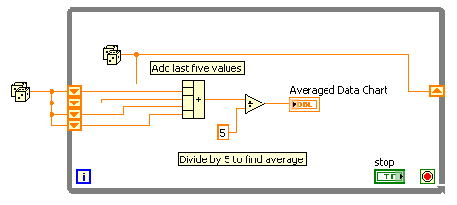
Stacked Shift Registers
Registers remember values from multiple previous iterations and carry those values to the next iterations
Values “bump down” with each iteration
To create:
Right-click » Add Element
Expand the left side register (down arrows) up or down by dragging the small square when the mouse is a double arrow
Initial
Value
Note: Still only 1 register on right side
Notes:
Shift registers can be expanded to access data from multiple previous iterations.
-first iteration: all shift registers would have the value they are initialized with (value passed into the down arrow shift register) (random number, 0.32 = initial value). This value would be passed to the add function, that adds all 5 values it receives. A new random number (0.5) is passed to the right side shift register (up arrow)
second iteration: the top down-arrow would contain the new value (ie 0.5) and the lower three would still have their initial value (0.32)
-third iteration: the top down-arrow would contain the next new value (ie 0.87) and the second-from-the-top down-arrow would be 0.5, others would still be 0.32.
Fourth iteration: top down-arrow would contain the new value (ie 1.5) and the 2nd from top down-arrow would contain the 0.87, 3rd from the top would contain the 0.5 and the last would still be 0.3.
This “bump down” process would continue so that values from multiple previous iterations were available.
Introduction to LabVIEW Hands-On 83 ni.com

Slide 19
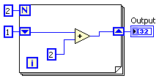
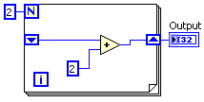
Shift Registers - Uninitialized
Run once
VI finishes
Run again
Block Diagram | 1st run | 2nd run
Initialized Shift Register | Output = 5 | Output = 5
Not Initialized Shift Register | Output = 4 | Output = 8
Notes:
This slide shows the output of the two block diagrams if the VI is run once, the user waits for the VI to finish, and the runs the VI again. The default value for an uninitialized shift register is zero, which is why the first time the VI with the uninitialized shift register is loaded into memory and run, the output is 4.
An uninitialized shift register will remember the last value it contained even if the VI stops running and is started again. To clear the value, the VI must be taken out of memory (closed) and then reopened. Alternatively, code should be put into place to allow for a “reinitialize” function.

Slide 20
Demonstration:
Operation of a Shift Register
Notes:
Run the VI: _____ in highlight execution to show how the values are passed along by the shift registers. Expand the shift register to show how the stacked shift register works.
Introduction to LabVIEW Hands-On 24 ni.com

Slide 21
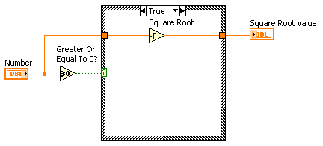
Case Structure
Case Selector Label
Selector Terminal
Have two or more subdiagrams or cases
Execute and displays only one case at a time
An input value determines which subdiagram to execute
Similar to case statements or if...then...else statements in text-based programming languages
Notes:
The value that is passed into the Selector Terminal determines which case will execute. The case structure can have many cases, but the case (shown in the Case Selector Label) must be unique. You can only have one “match” between the value passed into the Selector Terminal and the choices of cases.
Inside the borders of the case structure is the code that will execute. Only one case is displayed at a time, so, in this slide, the True case is shown. If Number is greater or equal to zero, then (the True case will execute and) the square root of Number will be calculated and passed out to the Square Root Value indicator terminal.
If a value is passed into the Selector Terminal that does not have a matching case, the default case will run. One case will automatically be set to default, however you can change which case is the default case by right-clicking on the Case Structure and selecting Make This the Default Case

Slide 22
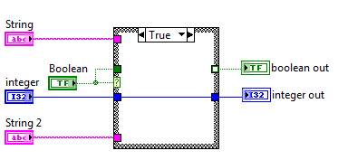
Case Structure: Inputs
You can create multiple input tunnels
Inputs are available to all cases, but do not have to be used in all cases
Notes:
A tunnel will be created on the edge of the case structure for the input. The tunnel does not have to be on the left edge, but generally is because data flow is left-to-right. The color of the tunnel will correspond with the data type and will be solid. You do not have to use any or all of the inputs in a given case.

Slide 23
Case Structure: Outputs
You can create multiple output tunnels
You must define each output tunnel for each case, otherwise
Wire every case (2)
Right-click » Use Default If Unwired (3)
(1)
(2)
(3)
Data Type | Default Value
Numeric | 0
Boolean | FALSE
String | Empty
Notes:
An “hollow” tunnel (1) will appear on the edge of case structure it there is not something wired to the output tunnel in every case. LabVIEW must know what to pass out of the case structure no matter which case is executed, so LabVIEW will give a broken run arrow as well. You have two options to fix a hollow tunnel: 1. wire something to the output tunnel in every case (then the tunnel will be solid) (2) or 2. right-click on the hollow tunnel and say Use Default If Unwired (3). If you choose option 2, then the default value displayed in the chart will be the output value. It is recommended that you limit the use of the Use Default If Unwired because it may not be obvious to you or someone else during troubleshooting later when unexpected values are passed out.

Slide 24
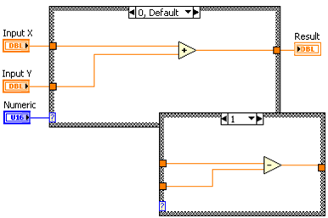
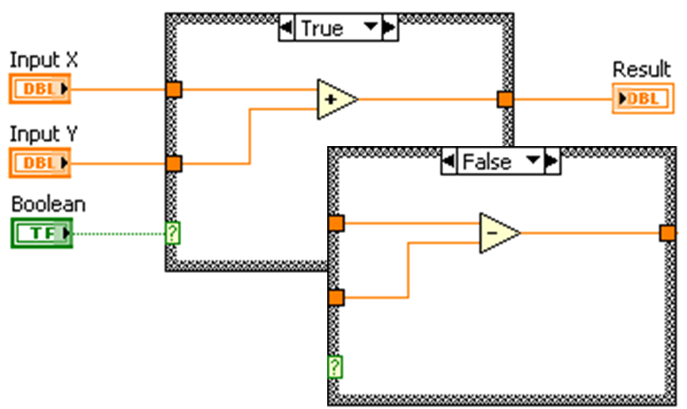
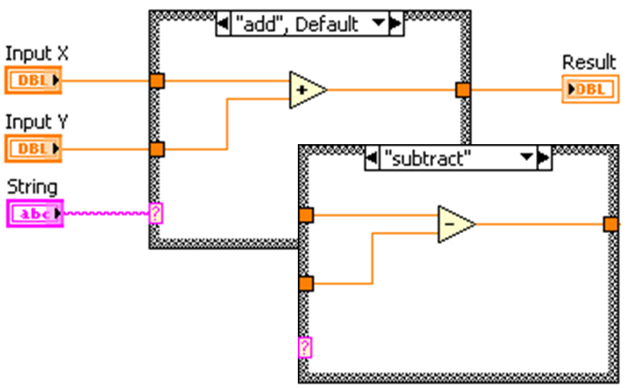
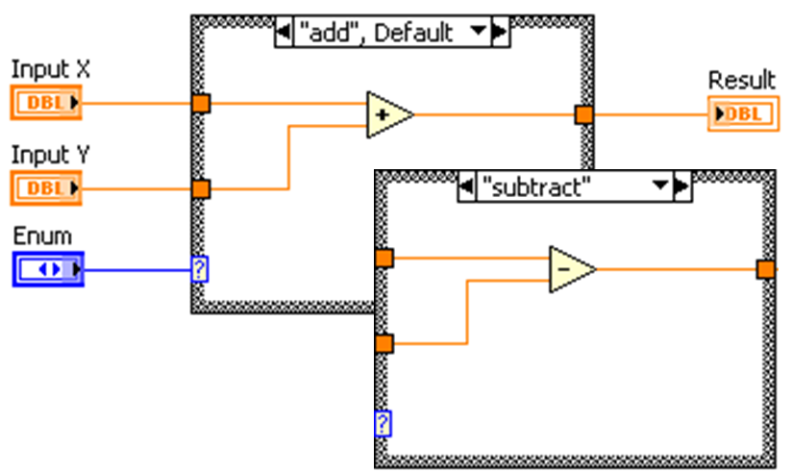
Case Structure
Notes:
A boolean is not the only data type that can be passed into the case selector. String, numerics, and enums are also valid.
Boolean: There will be 2 cases – a True and a False case.
Numeric: at least 1 case – the numeric value passed in must match the case. (case 0 and case 1 are shown)
String: at least 1 case – the string must match exactly (including white space). The match is based of ASCII characters, so capitalization matters.
Enum: a combo of numeric and string (see 2 slides after for more details). Helps with better association (easier to remember “Print” case than case “8”) but avoids the issue of typos or almost matches.

Slide 25
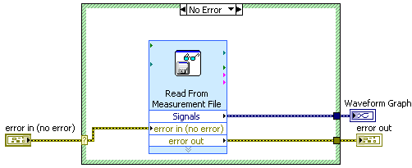
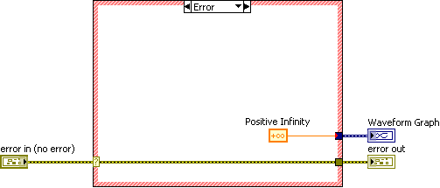
Case Structure
If the error cluster is wired to the selector, the border of the case structure automatically turns red or green for the error and non-error cases, respectively
Holy automatic coloring, Batman!
Notes:
An error cluster can be passed into the Selector Terminal. Two cases will be automatically generated : Error case (red) and No Error case (green). The Selector pulls the status boolean out of the error cluster automatically to generate the two cases.
There may be situations you want to handle a particular error (ie File not found error – then ask the user to pick one). You can unbundle the error cluster and pass the Code part of the error into the Selector to handle an error that has a particular code.

Slide 26
Demonstration:
Creating a Case Structure and Adding a Case
Notes:
Create a case structure
Show how to add a case
Wire an enum (that contains at least 3 choices) into the case selector and demonstrate adding a case for every value (right-click>> Add Case for Every Value
Introduction to LabVIEW Hands-On 24 ni.com

Slide 27
Homework
Create a VI using loops and case structures
Notes:
Introduction to LabVIEW Hands-On 24 ni.com

